Slide 1
Building systems from actors
From FPGA design to FPGA programming
Jörn W. Janneck
Xilinx Inc.

Slide 2
… as long as there were no machines, programming was no problem at all; when we had a few weak computers, programming became a mild problem, and now we have gigantic computers, programming has become an equally gigantic problem.
Edsger Dijkstra: The Humble Programmer
Turing Award Lecture, 1972

Slide 3
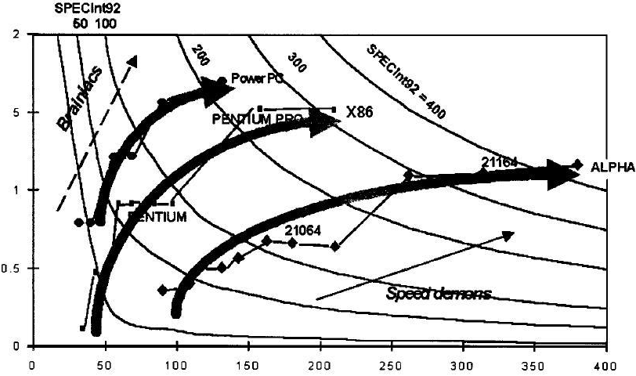
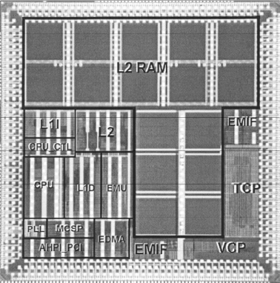
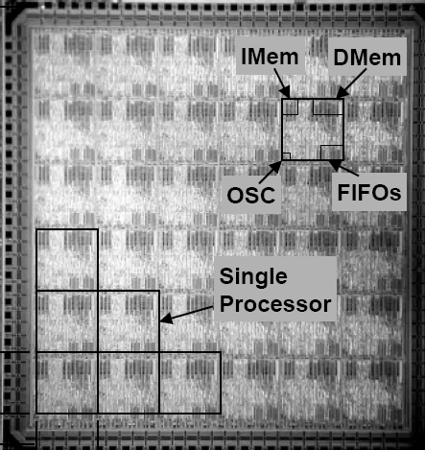
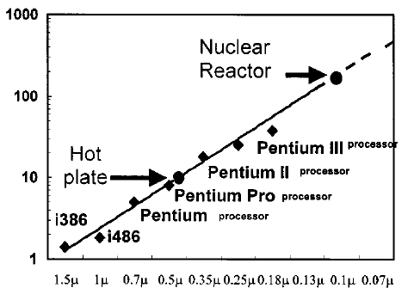
The Multi-core Imperative
End of roadmap for CPUs
context & motivation
goals
design vs programming
actors/dataflow
example
architectural exploration
conclusion
1945-2005
Sequential programming
CPUs are as smart as they can be!
Spot the CPU!
Clock frequency
scaling
L2 $
L1 $
SPECInt92/MHz
CPU
Source: Ronen [2001]
MHz
Source: Agarwala [2002]
TI 6416
Multi-core Arrays
With Moore’s law you also get leakage!
Divide and conquer
2005 - ????
Concurrent
programming
Absolute power limits
Source: Zu & Baas [2006]
6x6 GALS Processor Array
Source: Borkar [1999]
Notes:
Here is the cause-and-effect relationship that is driving us to more concurrent processing.
CPU architecture is no longer yielding more throughput per clock since we have played just about every trick in the book (Hennessy & Patterson). The diagram shows performance/clock plotted against clock for several CPU families. What we see is that after a period of evolution each architecture yields greater clock speed but no more computation per clock cycle, ie. Clock speed is the only way to get additional performance.
Another sign that there is nothing left but clock in the playbook is that modern CPUs are almost all cache. A very small fraction of TI’s 1GHz 8-issue VLIW is devoted to CPU. Most the transistors go into operand storage not compute.
In the deep submicron era power density is starting to impose absolute power limits so we can no longer continue clock frequency scaling as in the past.
The solution to providing more compute power is to move to multi-processor architecture. The die shown is an academic project, but Intel, Sun and IBM/Sony have all produced multi-core devices with 2 – 16 CPUs on board. Now the question of programming model which has vexed FPGA vendors for a while will start to trouble processor vendors as well.

Slide 4
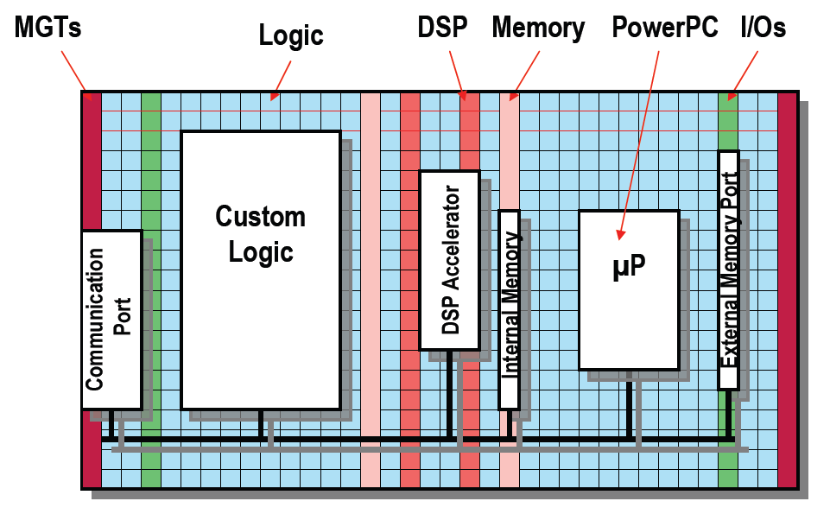
The Platform FPGA
context & motivation
goals
design vs programming
actors/dataflow
example
architectural exploration
conclusion
What’s special about a platform FPGA ?
  It’s big.
  It has a variety of different elements on it.
1985:
  128 4-LUTs
2006: [V5-LX]
  207360 6-LUTs
  10Mbit BRAM
  192 ALUs
Platform FPGAs have evolved from glue logic to
heavy-duty spatial computing devices.
Notes:
The size of a Platform FPGA is arguably the biggest challenge for a programming methodology targeting it. Because of their size, these chips will be used for large and complex designs. For this reason, the productivity of the design methodology shifts into focus. HDLs are fine for small or regular designs. For large, algorithmically complex designs, the productivity of HDLs conflicts with the fundamental value proposition of FPGAs, viz. that of reducing the NRE and TTM of hardware designs compared with ASICs.

Slide 5
Size matters, or the spatial software crisis
context & motivation
goals
design vs programming
actors/dataflow
example
architectural exploration
conclusion
lots of horse power, provided...
  ... the/your problem admits to a parallel (-izable) solution
  ... the/a/your solution admits to a parallel implementation
good news / bad news
  spatial computing devices commercially available
    large-scale spatial computing is now feasible
  FPGAs are programmed by designing circuits
    difficult, error-prone, unproductive, not fun,
    few people know how to do it well
spatial programmers are facing a “spatial software crisis”
Notes:
“software crisis”, first mentioned in “Software engineering: Report of a conference sponsored by the NATO Science Committee”, Peter Naur, Brian Randell (eds.), Garmisch, Germany, 7–11 October 1968, Brussels, Scientific Affairs Division, NATO (1969) 231pp.

Slide 6
What to do?
context & motivation
goals
design vs programming
actors/dataflow
example
architectural exploration
conclusion
No Silver Bullet [Fred Brooks, 1986]
  tools, languages, processes
  eliminate “accidental complexity”
  recognize “essential complexity”
dealing with the “essential complexity”
  concurrency
  communication
  control
  computation
spatial components
  should be to FPGAs what objects/classes are to processors

Slide 7
motivating methodology
context & motivation
goals
design vs programming
actors/dataflow
example
architectural exploration
conclusion
Quality of result (QoR) is not a design goal!
  Performance, power, BOM cost budgets make QoR a design constraint
The real objective is to meet the QoR target and minimize:
  Non-recurring engineering costs (NRE)
  Time-to-market (TTM)
The new methodology should save on design cost by enabling
  Design of portable, retargetable, composable IP blocks
  Rapid design space exploration and system composition
Abstraction
Profit
Traditional HDL Flow
QoR
performance/$
performance/W
New methodology
Total Design Cost
NRE $, TTM

Slide 8
computational efficiency rating and comparing QoR
context & motivation
goals
design vs programming
actors/dataflow
example
architectural exploration
conclusion
efficiency
(throughput / cost)
measure throughput with a
meaningful application metric
application-centric cost
- units of Watts or mm²
- for architecture comparison
use only resource consumed
in embedded apps excess
performance is usually
useless (hurting efficiency)
CPU
more efficient
must use logic
throughput
(computations/sec)
Legend
CPU
Logic
max throughput

Slide 9
What we want to achieve
context & motivation
goals
design vs programming
actors/dataflow
example
architectural exploration
conclusion
Make platform FPGAs as easy (or easier) to program
than DSPs.
Move from FPGA design to FPGA programming
  using FPGAs “the software way”
Exploit inherent concurrency of FPGA platform
  Single core processors nearing end of their roadmap
  Multi core processors no longer have an automatic programming model advantage over FPGAs.
Scalable FPGA performance, combined with a concurrent programming model, will enable us to close the gap and even surpass processors in ease-of-use.

Slide 10
ASSP Platform Programming
(e.g. TI daVinci)
context & motivation
goals
design vs programming
actors/dataflow
example
architectural exploration
conclusion
Applications
device agnostic code
Compliant Algorithms
component model
(API)
TMS320 DSP Algorithm Standard
Signal Processing Library
Full-featured layers of device dependent middleware, enabled by:
compiler technology
architectural compatibility
IP ecosystem
RTOS/BIOS
SW Drivers
Silicon
Board
vendor / 3rd party IP
customer design effort
Notes:
This is a diagram which shows the layers of IP used to program a complete application on an ASSP platform. I have used the TI daVinci device as a typical platform, and the details of the diagram are mostly from the TI website. The diagram is augmented with a hardware layer as well, and color coding is used to indicate who is primarily responsible for the functionality in each box. Components provided by the silicon vendor or 3rd parties are colored gray, and red is used to indicate the responsibility of the platform programmer. Boxes that are mixed indicate that both supplier and user may have to provide functionality at that level.
To maximize ease-of-use it is desirable to confine the user’s contribution to the highest levels of the stack where the programming is device agnostic. TI has done this quite successfully, thanks to a richly populated middle layer and comprehensive driver support for their hardened platform. Compiler technology helps to minimize the impact of architectural evolution, and they have also been successful at growing an IP ecosystem for their platforms.
TI also publishes an “algorithm standard”, backed up with a certification program, that minimizes the degree of device-dependence at the algorithmic layer by standardizing things like DMA transfer calls. Since all the IP for this hard platform is code, APIs and function signatures for the IP libraries can remain relatively stable across device families and generations, allowing them to focus more on growing the libraries than porting them.

Slide 11
Platform FPGA Design
Who creates what
context & motivation
goals
design vs programming
actors/dataflow
example
architectural exploration
conclusion
ASSP
Platform FPGA
Applications
Applications
Compliant Algorithms
Algorithmic Kernels
TMS320 DSP Algorithm Standard
Soft Platform
Signal Processing Library
RTOS/BIOS
SW Drivers
Cores
IO + Wrapper
Accelerators
RTOS/BIOS
SW Drivers
Silicon
Board
Silicon
Board
Soft platform approach opens door to multi-processing, but complicates methodology.
Notes:
Here is a visualization of the IP stack for the platform FPGA. The ASSP stack is show iconically on the left for reference, and I use the same color coding to distinguish vendor IP form customer IP.
In keeping with the Xilinx strategy of winning business away from ASICs, we have imposed a “soft platform” abstraction on top of the raw programmable features of the FPGA. This allows us to present a use model that is familiar to teams of former SOC/ASSP hardware and software engineers. The hardware designers can continue to create platforms consisting of processor, peripheral and accelerator blocks and the embedded systems programmers can write software for those software platforms as before. This has been a very successful strategy for winning over business from the ASIC/SOC camp, but it results in a design flow that is every bit as complicated as ASIC design itself.
We can see that there is user involvement at every level of the abstraction stack, implying an ease-of-use issue. This is exacerbated by the fact that migration of low-level IP across FPGA families and generations is a labor-intensive process, because our compiler technology lags the silicon by years in some cases.

Slide 12
Platform FPGA Design
Languages used
context & motivation
goals
design vs programming
actors/dataflow
example
architectural exploration
conclusion
ASSP
Platform FPGA
Applications
Applications
Compliant Algorithms
Algorithmic Kernels
TMS320 DSP Algorithm Standard
Soft Platform
Signal Processing Library
RTOS/BIOS
SW Drivers
Cores
IO + Wrapper
Accelerators
RTOS/BIOS
SW Drivers
Silicon
Board
Silicon
Board
C/C++/Assembly
System Generator, Platform Studio
AccelDSP
Hardware
HDL
Notes:
Here is a visualization of the IP stack for the platform FPGA. The ASSP stack is show iconically on the left for reference, and I use the same color coding to distinguish vendor IP form customer IP.
In keeping with the Xilinx strategy of winning business away from ASICs, we have imposed a “soft platform” abstraction on top of the raw programmable features of the FPGA. This allows us to present a use model that is familiar to teams of former SOC/ASSP hardware and software engineers. The hardware designers can continue to create platforms consisting of processor, peripheral and accelerator blocks and the embedded systems programmers can write software for those software platforms as before. This has been a very successful strategy for winning over business from the ASIC/SOC camp, but it results in a design flow that is every bit as complicated as ASIC design itself.
We can see that there is user involvement at every level of the abstraction stack, implying an ease-of-use issue. This is exacerbated by the fact that migration of low-level IP across FPGA families and generations is a labor-intensive process, because our compiler technology lags the silicon by years in some cases.

Slide 13
Platform FPGA Design
Implementation process
context & motivation
goals
design vs programming
actors/dataflow
example
architectural exploration
conclusion
Modularize & Compose
Divine-Create-Implement
Application
Application
Module
1. Divine
Module
Modularize & Compose
Module
Architecture
API
3. Implement
application
API
API
API
2. Create architecture
Processor
FPGA

Slide 14
actor/dataflow programming model
context & motivation
goals
design vs programming
actors/dataflow
example
architectural exploration
conclusion
point-to-point, buffered token-passing connections
guarded atomic actions
actors
Actions
State
encapsulated state

Slide 15
actors as spatial components
context & motivation
goals
design vs programming
actors/dataflow
example
architectural exploration
conclusion
key characteristics
  weak coupling
    small, explicit interfaces
  exposed parallelism
    make it available to tools, explicit to programmers
  encapsulation of state
  simplicity

Slide 16
actors as spatial components
context & motivation
goals
design vs programming
actors/dataflow
example
architectural exploration
conclusion
  The source of...
    ... reuse
    ... portability
    ... higher-level analyses and optimizations
  A conceptual base for new intellectual approaches and tools based on them:
    dataflow design patterns
    actor/dataflow refactoring
    actor/dataflow-based views on computation
      compute graphs (causation traces)
      models for token flows, statistical and others

Slide 17
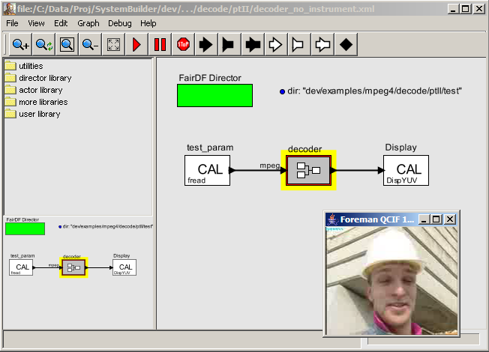
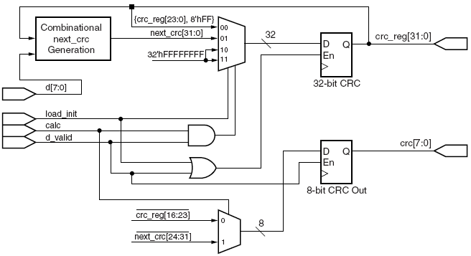
actor/dataflow toolflow
context & motivation
goals
design vs programming
actors/dataflow
example
architectural exploration
conclusion
actor source
+ network
simulation
class MyActor
{ schedule();
readPort( portNum );
writePort( portNum );
}
software
high-level synthesis
simulation
hardware

Slide 18
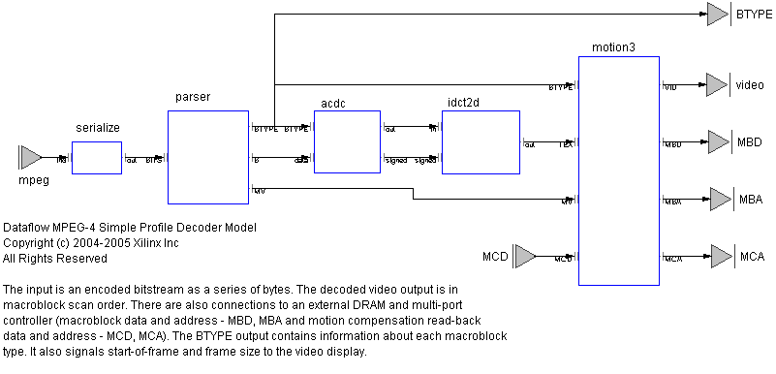
An example
context & motivation
goals
design vs programming
actors/dataflow
example
architectural exploration
conclusion
MPEG4 SP decoder

Slide 19
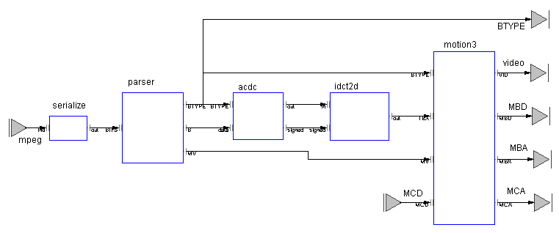
FPGA Programming In Practice
Networked MPEG-4 Viewer
context & motivation
goals
design vs programming
actors/dataflow
example
architectural exploration
conclusion
Microblaze running LWIP protocol stack
XUP Board
(2VP30)
Ethernet
UDP
Raster Scan Actor
Decoder Actor Network
VGA Display IP
VGA
Display IP
Memory Controller
UDP over Ethernet
Remote Video Stream Server
Local
VGA Monitor
Notes:
Here is a block diagram of a working system of significant complexity that we will demo at the Labs Day exhibition on November 9th.
The diagram uses the same color scheme as the previous slides, with the gray boxes representing library IP and the red boxes representing unique programming in support of the application. This shows “Platform FPGA Programming” at work today. The algorithmic core of the system, an MPEG-4 decoder, is implemented as a dataflow network. Several support functions (“hardware drivers”) were also created to make this application work on a specific platform, and the rest of the IP is off-the-shelf Xilinx IP provided through Platform Studio, or as part of the board support package for the XUP board.
The decoder has the same configuration, and was verified using the same test vectors, as a VHDL implementation created in the Labs, to permit direct comparison on quality-of-result. A separate rasterizing actor converts the YUV4:2:0 macroblock output of the decoder into RGB4:4:4 raster-scan for display on a local VGA controller. A small “shim”, written in HDL, converts the control signals for a stock multi-port memory controller into the token-passing protocol employed in the actor/dataflow component model.
Connectivity is provided by a Microblaze running LWIP (the open-source Light Weight Internet Protocol stack), which is supplied with Platform Studio. The dataflow protocol is pin-compatible with FSL links, making it simple to mix hardware and software Actors. Platform Studio is used to assemble the Microblaze and all the other HDL IP blocks into a single component with dataflow ports. This is then linked to the Actor network produced by SystemBuilder in a scripted ISE flow to produce the final bit stream.
During the final debug of the system, the Microblaze provided network connectivity in both directions so that the hardware on the board could communicate with a dataflow simulation on the host computer. Sub-networks of the decoder were moved onto the board one at a time so that correctness of the physical implementation could be verified piecemeal in cosimulation with the dataflow testbench and test vectors on the host.

Slide 20
MPEG-4 SP Decoder
QoR
context & motivation
goals
design vs programming
actors/dataflow
example
architectural exploration
conclusion
Version | Area |  |  |  |  | Performance
 | Slice | LUT | FF | BRAM | MULT
VHDL IP ¹ (15000 lines) | 4637 | 7923 | 2637 | 26 ² | 34 | 4-CIF image size 180K macroblock/s @ 100MHz Requires ZBT SRAM framebuf
CAL decoder (4000 lines) | 3872 | 7720 | 3576 | 22 ³ | 7 | HD image size 243K macroblock/s @ 120MHz Interfaces to DRAM framebuf I-frame parsing: 50 Mbit/s
¹ http://www.xilinx.com/bvdocs/ipcenter/data_sheet/ds520_prod_brf.pdf
² BRAM-limited to 4-CIF image size.
³ Supports HD image size. Reduces to 16 BRAMs for 4-CIF image size.

Slide 21
Comparing
Decoder Solutions
context & motivation
goals
design vs programming
actors/dataflow
example
architectural exploration
conclusion
relative area efficiency
  10
  5
d
  2
c
  1
a
b
CIF
SD
HD
10
100
1000
throughput
macroblocks/sec
x1000
a TI64xx MPEG-4 (CPU + L1 cache only)
b FPGA MPEG-4 using traditional HDL flow (12 MM effort)
c FPGA MPEG-4 using actor/dataflow synthesis (3 MM effort)
d ISSCC’06 H.264 capable (includes periphery)

Slide 22
Smaller, Faster, Easier
Too good to be true?
context & motivation
goals
design vs programming
actors/dataflow
example
architectural exploration
conclusion
This is what happens when design effort is constrained.
The key is enabling architectural exploration with rapid turn-around time.
New decoder architecture incorporates many improvements over original design in motion compensation, AC/DC reconstruction, parser, 2-d IDCT.
Approximate manpower numbers:
  VHDL decoder: 12 months
  Dataflow decoder: 3 months

Slide 23
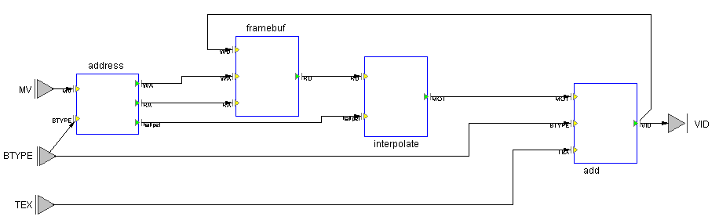
Architectural Exploration
MPEG4 Motion Compensator
context & motivation
goals
design vs programming
actors/dataflow
example
architectural exploration
conclusion
video stream feedback
PROBLEM!
Memory latency for random access reads and writes prevents real-world operation at HD rates.
video frame buffer
(off-chip DRAM)

Slide 24
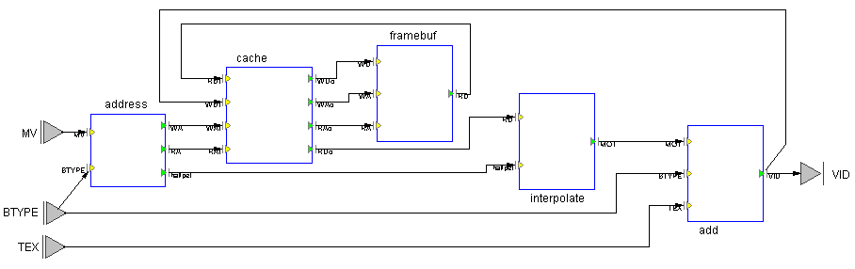
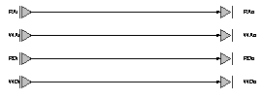
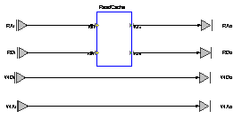
First Step:
Try on-chip cache
context & motivation
goals
design vs programming
actors/dataflow
example
architectural exploration
conclusion
Break the address and data streams, insert a cache placeholder.
Insert different policies, see what happens.
policy1
Pass-through just to make sure model is OK.
policy2
Insert a cache actor in the read path and monitor statistics.

Slide 25
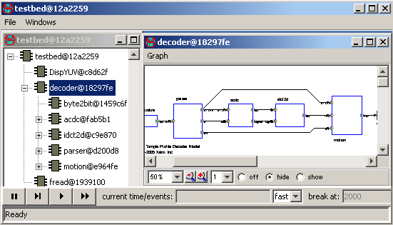
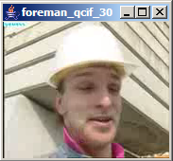
Simulation result with policy2
context & motivation
goals
design vs programming
actors/dataflow
example
architectural exploration
conclusion
Memory controller performance
133MHz clock
32 pixel cache line fill
in ~18 cycles
Worst case compensation is
81 reads for an 8x8 block.
8.3% miss rate implies
average read is ~ 2.4 cycles
Rate limit is 44 Mpixel/s
HD (1920p, 4:2:0, 30fps) rate target is 93.3 Mpixel/s
Options for improvement
- more expensive controller
- much better cache policy
- application-aware prefetch
Monitor console
Frame 1 OK time: 28111ms
Frame 2 OK time: 23834ms
Requests: 49456, Hits: 45360
Miss rate: 8.28%
Frame 3 OK time: 27369ms
Requests: 98704, Hits: 90512
Miss rate: 8.30%

Slide 26
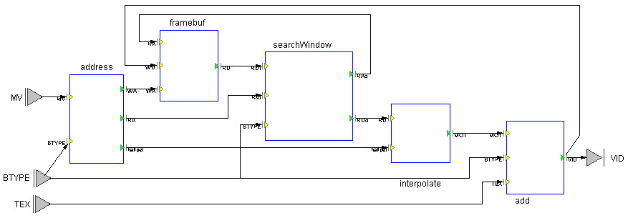

Step2:
Application-aware prefetch
context & motivation
goals
design vs programming
actors/dataflow
example
architectural exploration
conclusion
prefetch requests to frame buffer
prefetch data
replace cache with “search window”
compensation addresses now relative to search window
search window senses block type

Slide 27
Results of prefetch strategy
context & motivation
goals
design vs programming
actors/dataflow
example
architectural exploration
conclusion
Better performance
  prefetch needs to operate at 3x pixel rate
  exploits longer burst read with application-awareness
  (longer cache line did not help policy2 significantly)
  64 pixels in 26 cycles → average read is ~ 0.4 cycles
  peak theoretical performance is 111 Mpixel/s
  exceeds HD rate target with cheap DRAM
Substantial change to overall model behavior, but
  impact limited to two actors
  no refactoring of control in other actors needed

Slide 28
Final remarks
context & motivation
goals
design vs programming
actors/dataflow
example
architectural exploration
conclusion
Several real problems
  productivity, portability, robustness, ... in spatial programming
Need to identify and implement
  the right component model
  the right language for it
  a good translation to a variety of computing devices
High payback
  Whoever gets them right first wins big.
Uncertain which language FPGA users will use in 2016
  ... but we know some which they are probably NOT going to use very much: Verilog, VHDL, C, Java

Slide 29
What's the best thing you could be working on, and why aren't you?
Paul Graham, “Good and Bad Procrastination”
Thank You.
Credits:
Dave B. Parlour, Ian A. Miller, Johan Eker, Edward A. Lee, and many others.
CAL actor language: embedded.eecs.berkeley.edu/caltrop
Ptolemy II: ptolemy.eecs.berkeley.edu

Slide 30
programming language adoption
Name TPCI TPCI cum. Year
C 17.66% 17.66% 1973
C++ 11.06% 28.73% 1985
Perl 5.48% 34.20% 1987
Python 3.47% 37.67% 1990
VB 9.73% 47.40% 1991
Delphi 2.15% 49.54% 1994
Java 21.17% 70.72% 1995
PHP 9.86% 80.58% 1995
JavaScript 2.20% 82.78% 1995
C# 3.07% 85.85% 2002
100
cumulative TCPI by
language creation date
(for top 10 languages)
Java
PHP
JavaScript
C#
50
Delphi
VB
Perl
Python
C++
C
1970
1975
1980
1985
1990
1995
2000
2005
source: TIOBE Programming Community Index, TPCI, October 2006, http://www.tiobe.com/tpci.htm

Slide 31
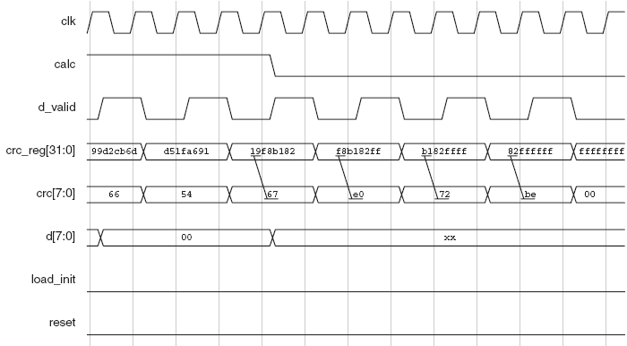
Merging Mindsets:
Software Design vs. Hardware Design
class A
class C
☑ Encapsulation
☑ Abstraction
☑ Portability
☑ Re-use
start()
class D
Implementation Detail ☒
Control Logic ☒
Interface Glue ☒
Concurrency ☑
Communication ☑
Architecture ☑
class B
resourceA
resourceB
resourceC
Events
☑ Protocols
Ordering
☒ Sequential
execution
Clocks ☒
Signals ☒
Timing ☒
Combining the strengths of both paradigms can bring about a radical improvement in hardware/software system design productivity.

Slide 32
Platform FPGA Programming
ASSP
Platform FPGA
Applications
Applications
Actor + dataflow network description
Compliant Algorithms
Algorithmic Kernels
TMS320 DSP Algorithm Standard
Dataflow Component Model
IP in any format with dataflow component model interface, e.g.
SystemGenerator
AccelDSP
Platform Studio
Coregen
HDL
Signal Processing Library
Core Library
RTOS/BIOS
SW Drivers
No RTOS!
Drivers
Silicon
Board
Silicon
Board
Soft platform + program replaced with a single-source concurrent application.
Notes:
The SystemBuilder vision is that the “soft platform” abstraction is replaced by the description of the application itself. This description of the application is a network of actors which are implementation agnostic. Actors can be mapped during the implementation phase to either hardware or software, and software actors can share a processor or be mapped to multiple processors. The dataflow component model allows actor networks to be composed easily, since interfaces and connections are synthesized automatically (hardware-hardware, hardware-software or software-software).
Without the concept of a soft platform, the user programming activity is mostly moved to the top of the stack as in the ASSP case. However, there is one important simplification. Since the dataflow program is a concurrent description of the execution there is no requirement for an RTOS to manage multiple threads on a processor, or for complicated DMA programming to effect inter-processor communications on multi-processor systems. This is key to achieving scalable performance and ease-of-use superior to that of processor-based platforms for DSP systems.
SystemBuilder does not solve the compilation problem that limits the portability of our lower-level IP, but it helps. Algorithms and applications are described in away that makes them much less dependent on the implementation characteristics of lower-level building blocks (eg timing and latency). This will allow us to build up a suite of application-level solutions that will transition smoothly from generation to generation. We are currently stuck in a mode where ASSPs appear before we get our IP released (eg. MPEG-4), so we miss the window of opportunity where evolving standards necessitate a programmable solution.

Slide 33
[A] language that makes source code ugly is maddening to an exacting
programmer, as clay full of lumps would be to a sculptor.
At the mention of ugly source code, people will of course think of Perl.
But the superficial ugliness of Perl is not the sort I mean. Real ugliness
is not harsh-looking syntax, but having to build programs out of the
wrong concepts. Perl may look like a cartoon character swearing, but
there are cases where it surpasses Python conceptually.
Paul Graham, “The Python Paradox”

Slide 34
Designing for programmers
A really good language should be both clean and dirty: cleanly
designed, with a small core of well understood and highly orthogonal operators,
but dirty in the sense that it lets hackers have their way with it. [...]
A good programming language should have features that make the kind of
people who use the phrase "software engineering" shake their heads
disapprovingly. [...]
To be attractive to hackers, a language must be good for writing the kinds of
programs they want to write. And that means, perhaps surprisingly, that it has
to be good for writing throwaway programs.
Paul Graham, “Being Popular”

